Slide 1
CHAPTER THREE
Inter-thread and inter-process communications using shared memory, pipes and sockets

Slide 2
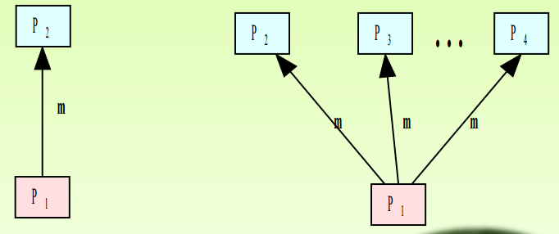
Inter-process communication
What is IPC?
Process: Running program is called a process.
IPC: Exchange of data between two or more separate, independent processes Operating systems provide facilities for inter-process communication (IPC).
L
Uni-cast Multi-cast

Slide 3
cont’d
Processes within a system may be independent or cooperating
Cooperating process can affect or be affected by other processes, including sharing data
Reasons for cooperating processes:
Information sharing
Computation speedup
Modularity
Convenience
Two models of IPC
Shared memory
Message passing

Slide 4
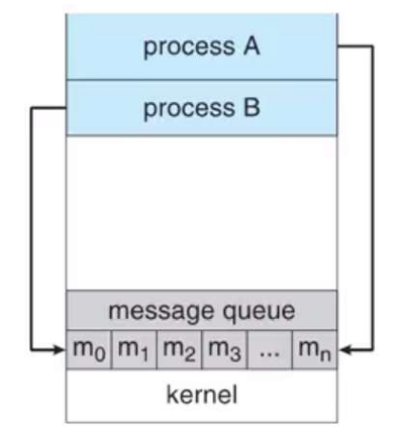
Communication Models
Message passing model:

Slide 5
Message passing cont’d
Mechanism for process to communicate and synchronize their actions
Message system process communicate with each other without resorting to shared variables
IPC facility provides two operations:
Send(message)-message size fixed or variable
Receive(message)
If P and Q wish to communicate, they need to:
Establish a communication link between them
Exchange messages via send/receive
Implementation of communication link
Physical (e.g. shared memory , hardware bus)
Logical( e.g. direct or indirect, synchronous or asynchronous)

Slide 6
Cont’d
Implementation questions
How are links established?
Can a link be associated with more than two processes?
How many links can there be between every pair of communicating processes?
What is the capacity of a link?
Is the size of a message that the link can accommodate fixed or variable?
Is a link unidirectional or bi-directional?
There are two ways of link establishment
Direct communication
Indirect communication

Slide 7
Direct communication
Processes must name each other explicitly:
Send (P, message) –send a message to process P
Receive (Q, message) –receive a message from process Q
Properties of direct communication link
A link is associated with exactly one pair of communicating processes
Between each pair there exists exactly one link
The link may be unidirectional, but is usually bi-directional

Slide 8
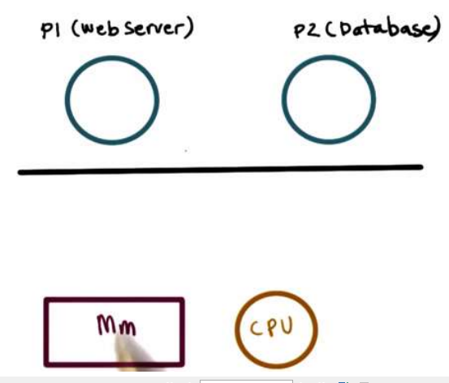
Indirect communication
Messages are directed and received mailboxes (also referred to as Ports).
Each mailbox has a unique id
Processes can communicate only if they share a mailbox
Properties of Indirect communication link
Link established only if processes share a common mailbox
A link may be associated with many processes
Each pair of processes may share several communication links
Link may be unidirectional or bi-directional

Slide 9
Cont’d
Mechanisms
Transfer data/info between address spaces
Maintain protection and isolation
Provide flexibility and performance
Processes
Write(send) and read(receive)
Advantage is that OS manages
Disadvantage is overheads

Slide 10
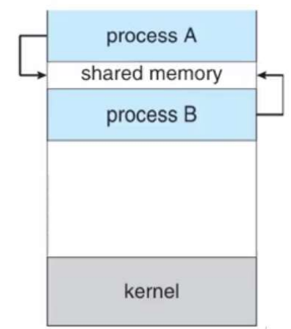
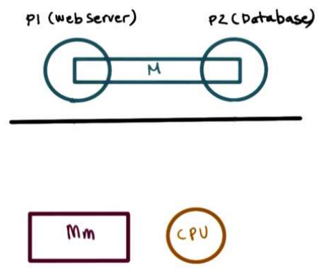
II. Shared memory
OS establishes shared channel and maps it into each process address space
Processes directly read/write from this memory
OS is out of the way

Slide 11
Race Conditions
In operating systems, processes that are working together share some common storage (main memory, file etc.) that each process can read and write.
When two or more processes are reading or writing some shared data and the final result depends on who runs precisely when, are called race conditions.
Concurrently executing threads that share data need to synchronize their operations and processing in order to avoid race condition on shared data.
Only one ‘customer’ thread at a time should be allowed to examine and update the shared variable.
Race conditions are also possible in Operating Systems.

Slide 12
Cont’d
If the ready queue is implemented as a linked list and if the ready queue is being manipulated during the handling of an interrupt, then interrupts must be disabled to prevent another interrupt before the first one completes.
If interrupts are not disabled then the linked list could become corrupt.
Critical Section
The key to preventing trouble involving shared storage is find some way to prohibit more than one process from reading and writing the shared data simultaneously.
That part of the program where the shared memory is accessed is called the Critical Section.
To avoid race conditions and flawed results, one must identify codes in Critical Sections in each thread.

Slide 13
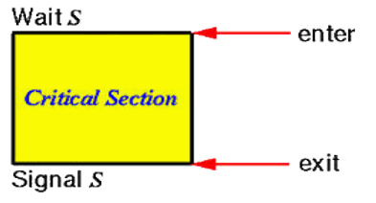
Cont’d
The characteristic properties of the code that form a Critical Section are:
Codes that reference one or more variables in a “read-update-write” fashion while any of those variables is possibly being altered by another thread.
Codes that alter one or more variables that are possibly being referenced in “read-update-write” fashion by another thread.
Codes use a data structure while any part of it is possibly being altered by another thread.
Codes alter any part of a data structure while it is possibly in use by another thread.
Here, the important point is that when one process is executing shared modifiable data in its critical section, no other process is to be allowed to execute in its critical section.
Thus, the execution of critical sections by the processes is mutually exclusive in time

Slide 14
Mutual exclusion
A way of making sure that if one process is using a shared modifiable data, the other processes will be excluded from doing the same thing.
Formally, while one process executes the shared variable, all other processes desiring to do so at the same time moment should be kept waiting; when that process has finished executing the shared variable, one of the processes waiting; while that process has finished executing the shared variable, one of the processes waiting to do so should be allowed to proceed.
In this fashion, each process executing the shared data (variables) excludes all others from doing so simultaneously. This is called Mutual Exclusion.
Note that mutual exclusion needs to be enforced only when processes access shared modifiable data - when processes are performing operations that do not conflict with one another they should be allowed to proceed concurrently.

Slide 15
IPC Methods
File – used to store resources for sharing
Signals-
used in UNIX operating system (occurs in process interruption)
Signal is a mechanism to communication between multiple processes by way of signaling. This means a source process will send a signal (recognized by number) and the destination process will handle it accordingly.
Sockets- provides p2p communication and 2-way communication b/n two processes

Slide 16
IPC Methods
Message queue –
Provides asynchronous or communication protocol (no need of sender and receiver to interact at the same time)
Communication between two or more processes with full duplex capacity. The processes will communicate with each other by posting a message and retrieving it out of the queue. Once retrieved, the message is no longer available in the queue.
Pipe
Access the O/P of each process (stdout) feeds directly as I/P (stdin)
Communication between two related processes. The mechanism is half duplex meaning the first process communicates with the second process. To achieve a full duplex i.e., for the second process to communicate with the first process another pipe is required.

Slide 17
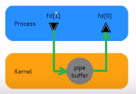
Pipes
Are used between parent and child
Always unidirectional
Accessed by two associated file descriptors
Fd[0] for reading from pipe
Fd[1] for writing to the pipe

Slide 18
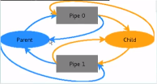
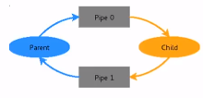
Pipes for two way communication
Two pipes opened pipe0 and pipe 1 . Close unnecessary pipes
Note the unnecessary pipes

Slide 19
End

